Slide 1
IRIGATOR
The automated gardener

Slide 2
WHY IRIGATOR?
Effective gardening with little power consumption
Reliable info sent to your remote device
Cheap and affordable

Slide 3
IRIGATOR REASONS
People’s need to grow plants
Easy maintenance of crops/plants
Reduced water/ energy use

Slide 4
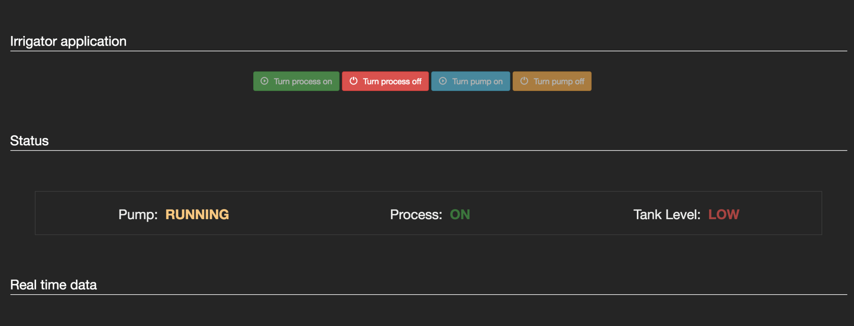
INTERFACE GUIDE

Slide 5
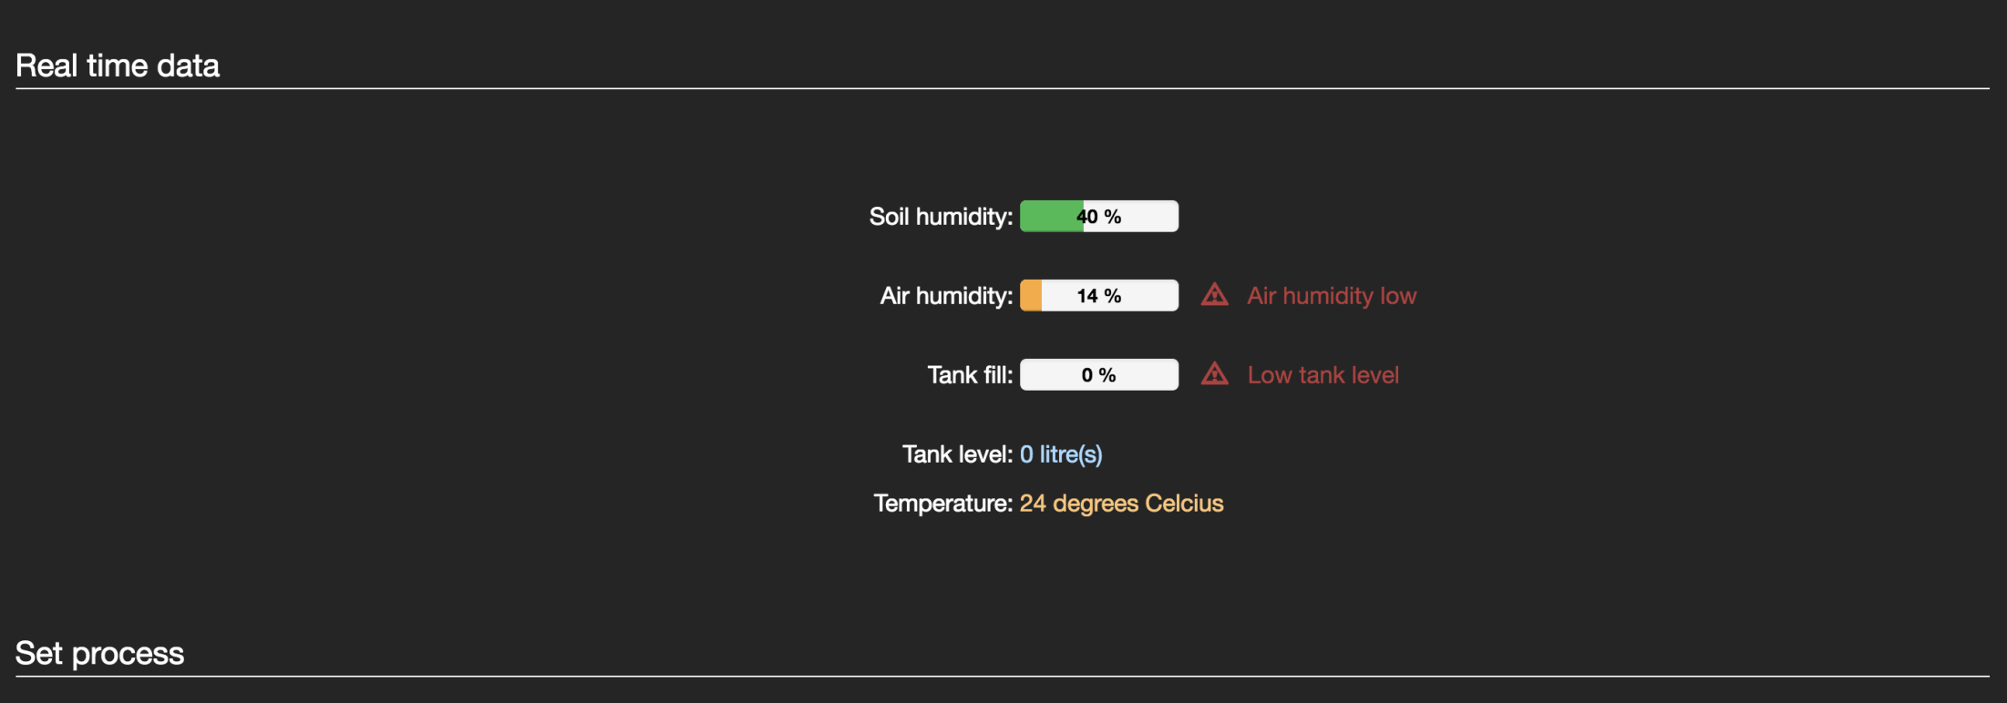
INTERFACE GUIDE

Slide 6
INTERFACE GUIDE

Slide 7

INTERFACE GUIDE
More details in the word documentation.

Slide 8
HOW DOES IRIGATOR WORK?
Sensor data gathering
WEB Server
Communication
Clients

Slide 9
COMPONENTS
Arduino Mega 2560 board with Ethernet Shield
Sensors ( Brick Humidity Sensor, HygroMeter etc…)
ASUS RT-N12 Router
Power Source (5V DC, 3.3V DC)
Cables and Components( Ethernet Cable, Breadboard)
More details in irrigator_hardware.doc

Slide 10
IRIGATOR REQUIREMENTS
Internet Connection
A.C. Power supply ( Common Socket)

Slide 11
THE END

